Slide 1



رحلة في عالم Big Data

Slide 2


Slide 3


Slide 4


Slide 5
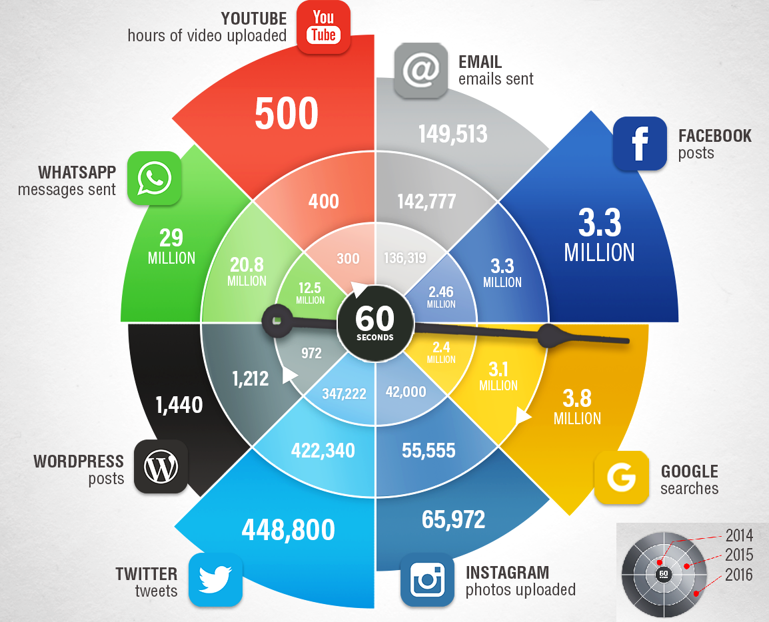

Slide 6
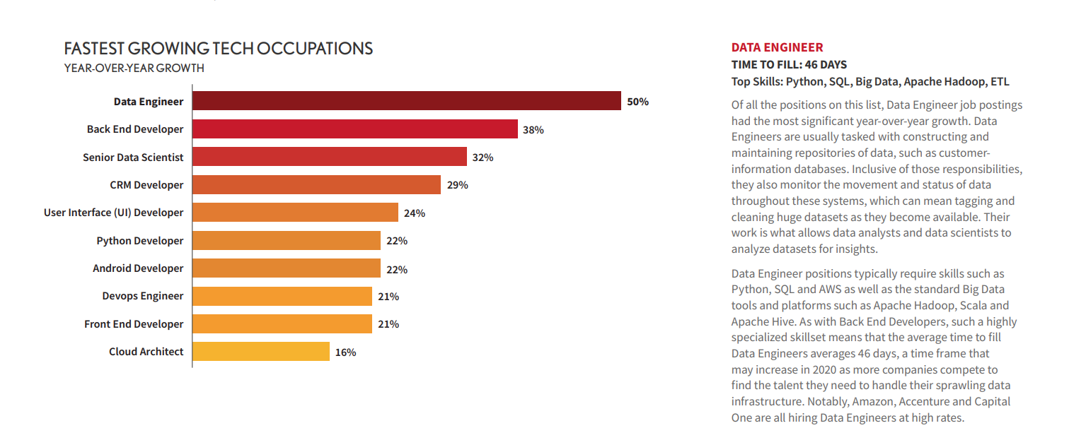


Slide 7

ما هو Data Ecosystem

Slide 8
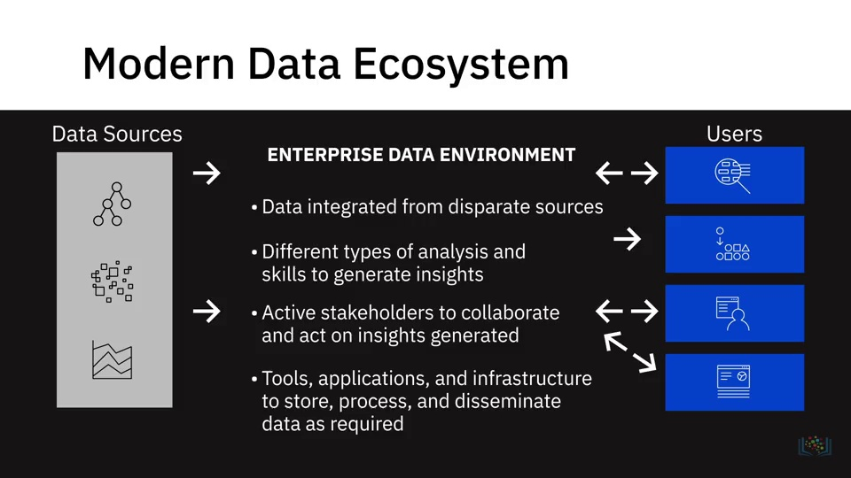

Slide 9
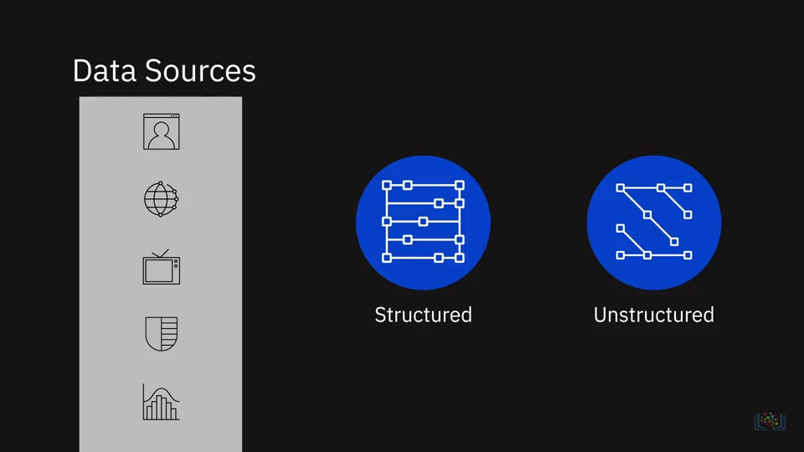
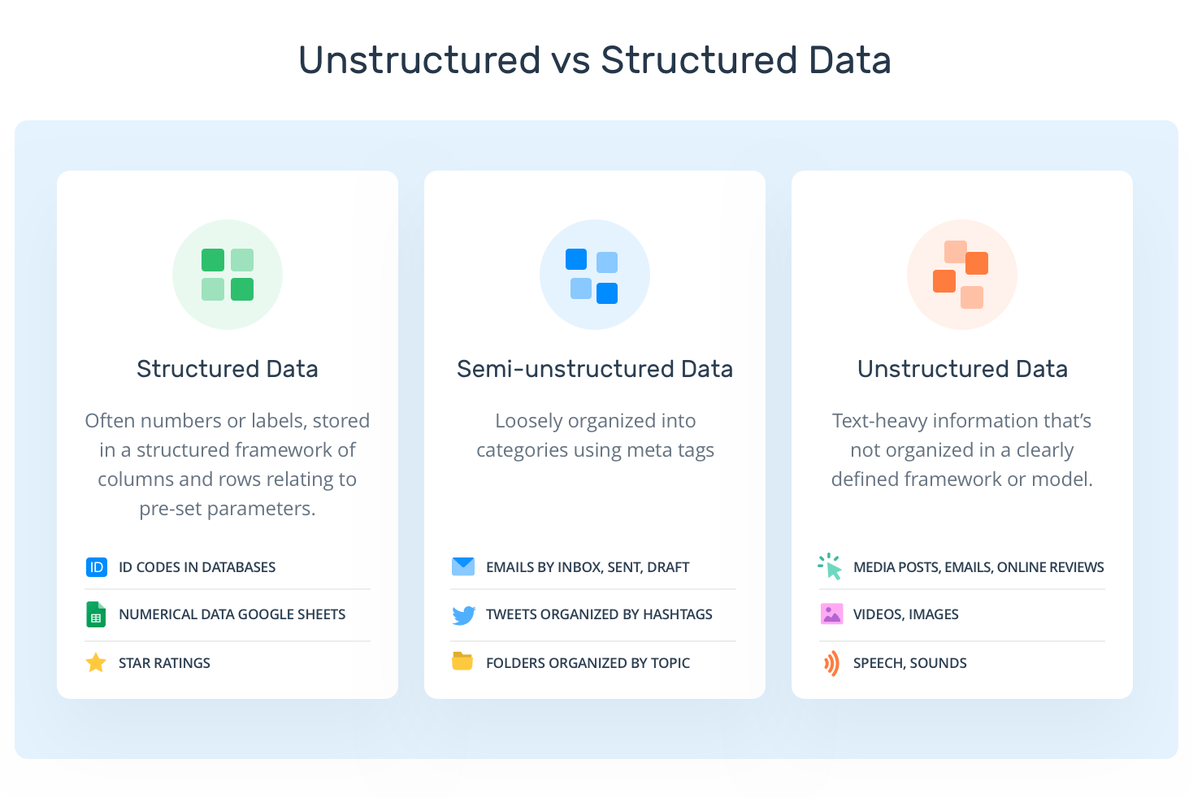

Slide 10
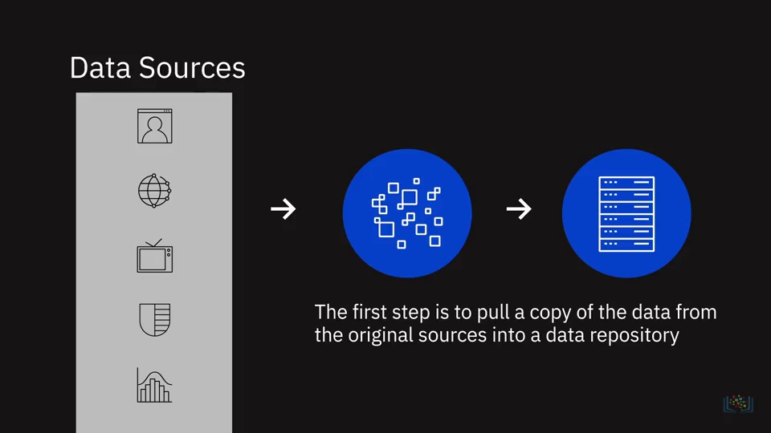

Slide 11
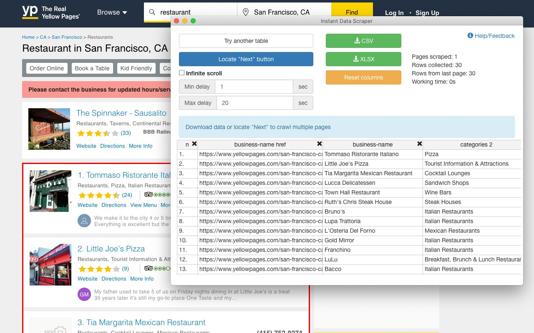

Slide 12
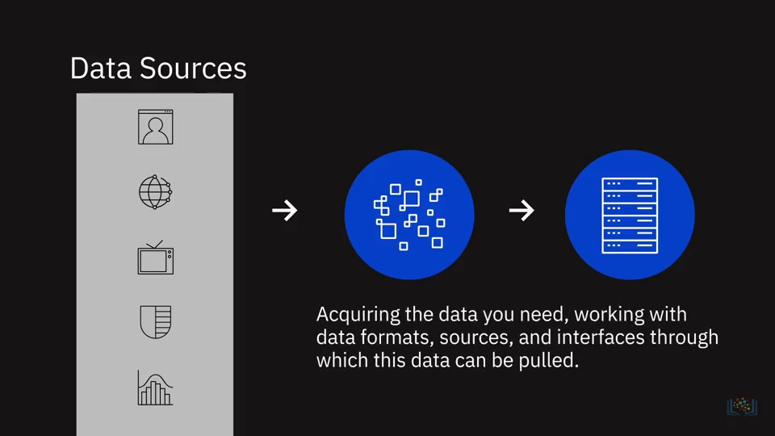

Slide 13
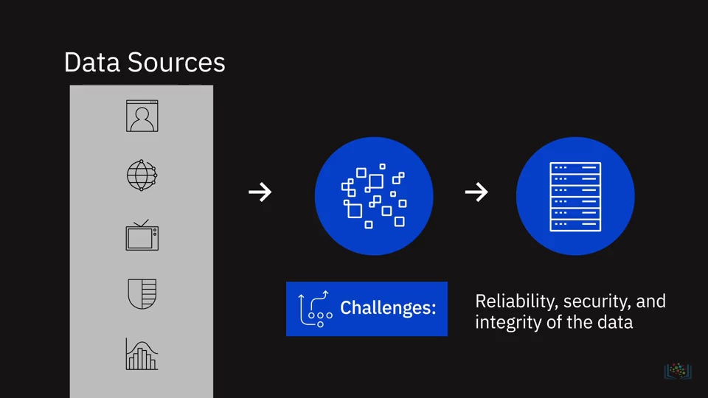
Notes:
1- Accuracy
2- Security
3- Quality

Slide 14
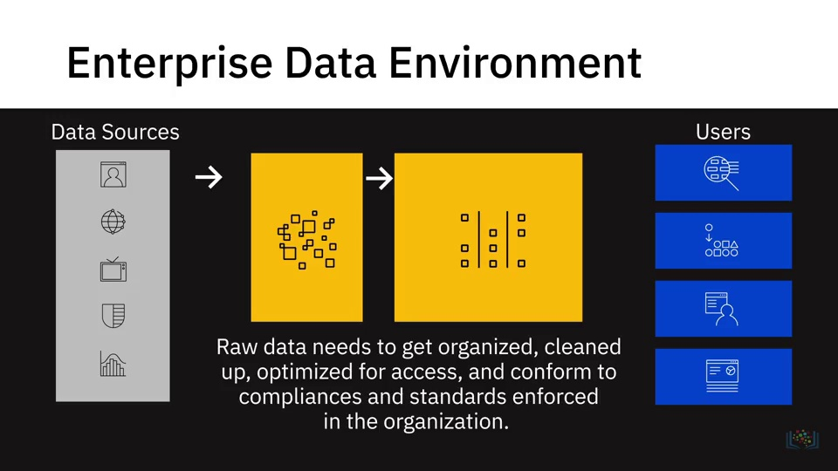
Notes:
تتفق مع المواصفات والمعايير المطبقة

Slide 15
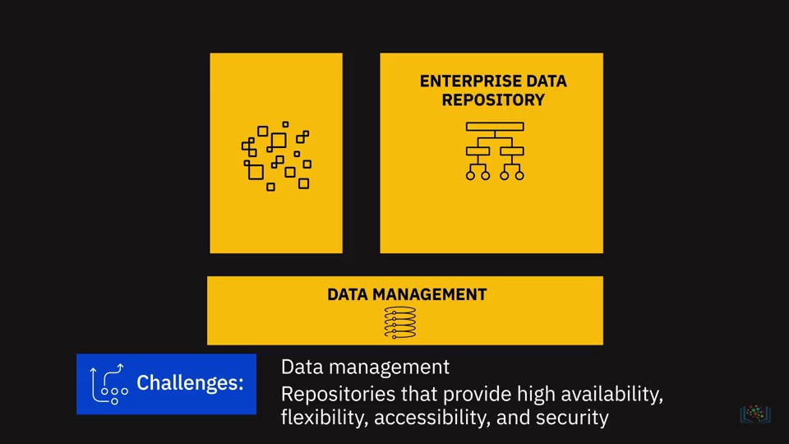

Slide 16
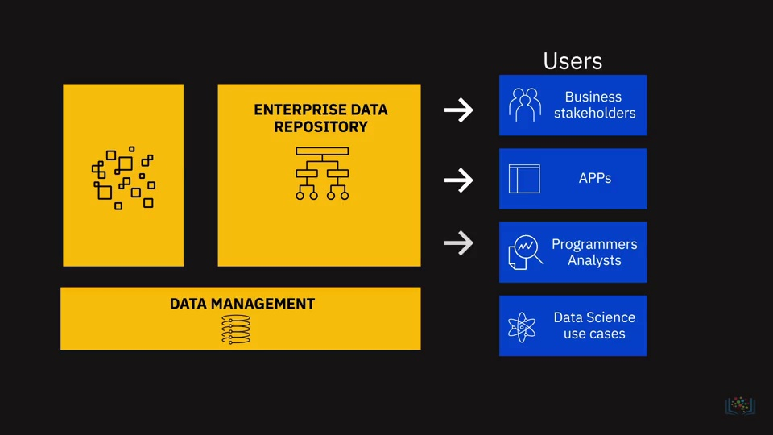

Slide 17
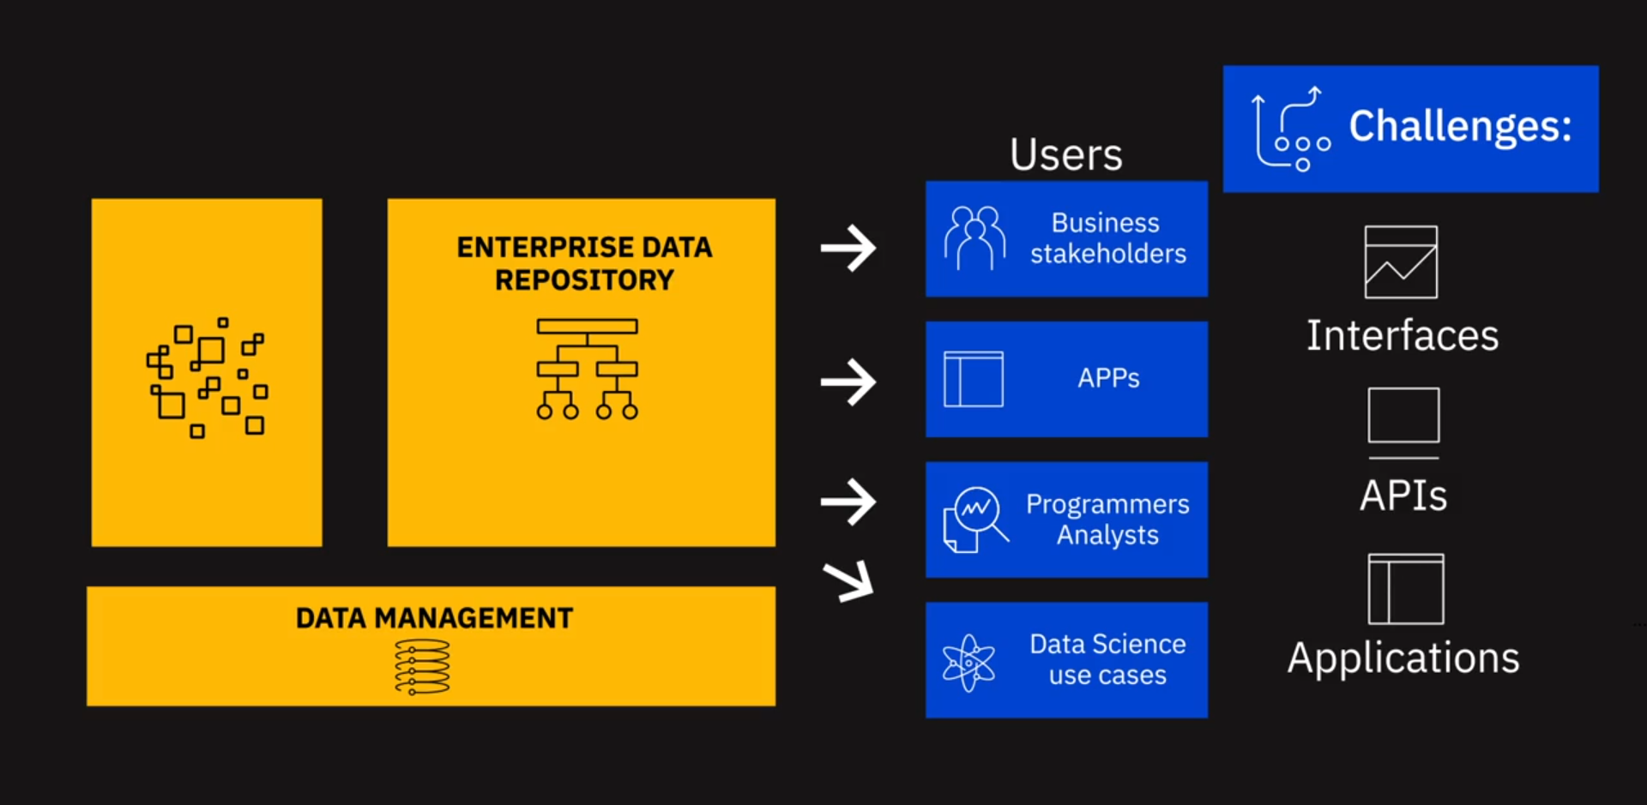
Notes:
as specified need

Slide 18
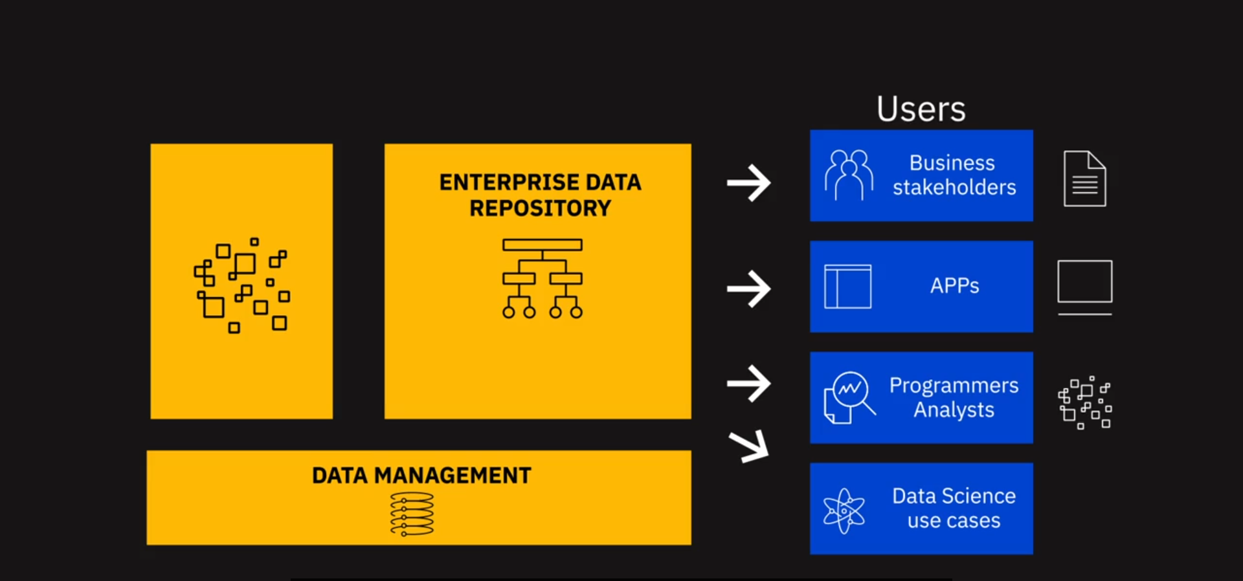
Notes:
Test and Dashboard
API
Raw Data

Slide 19
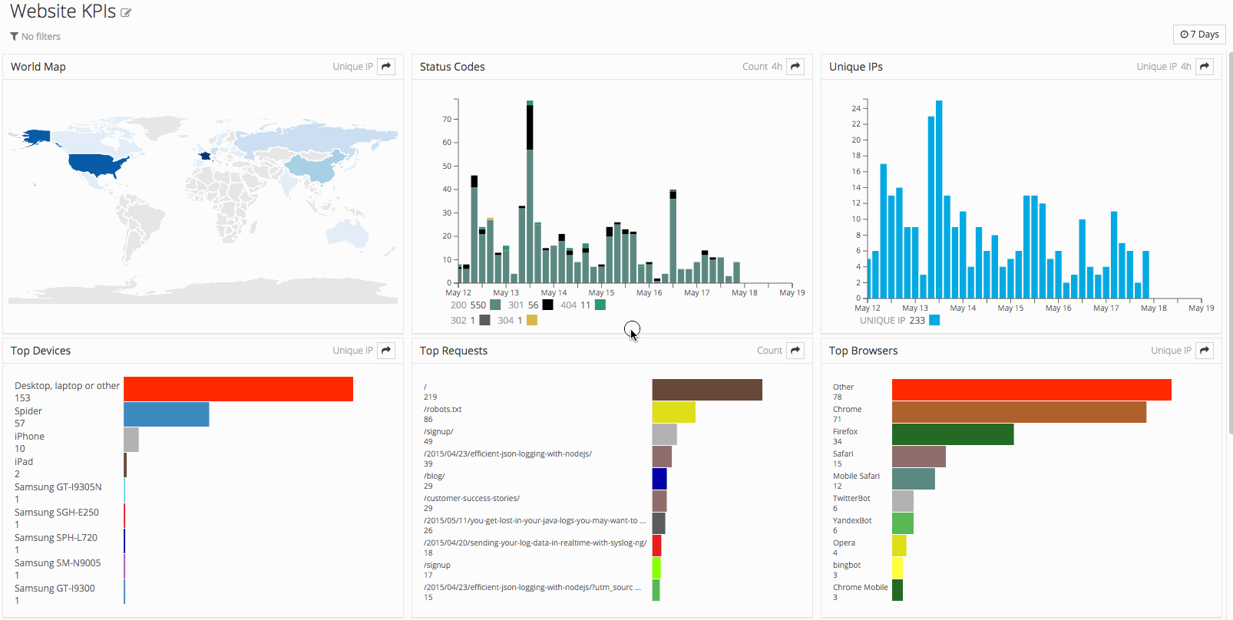

Slide 20
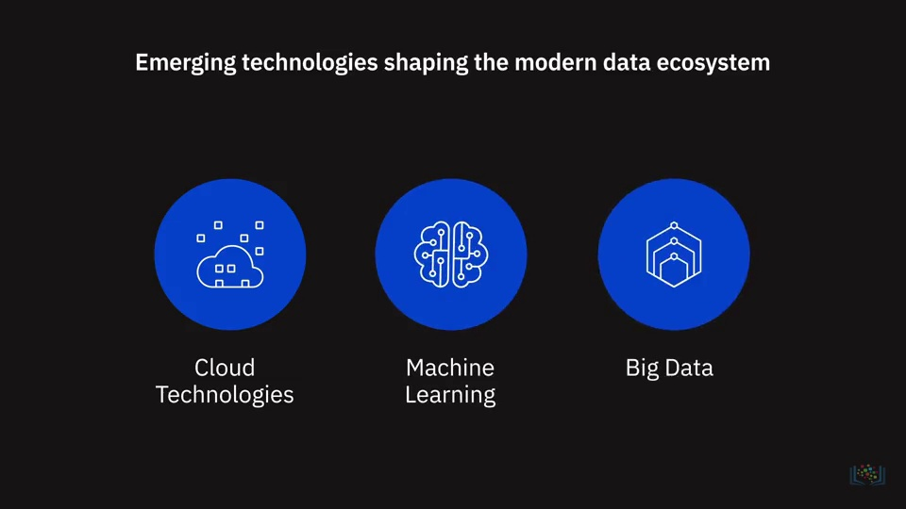
Notes:
التقنيات المطلوبة لتشكيل نظام البيانات

Slide 21
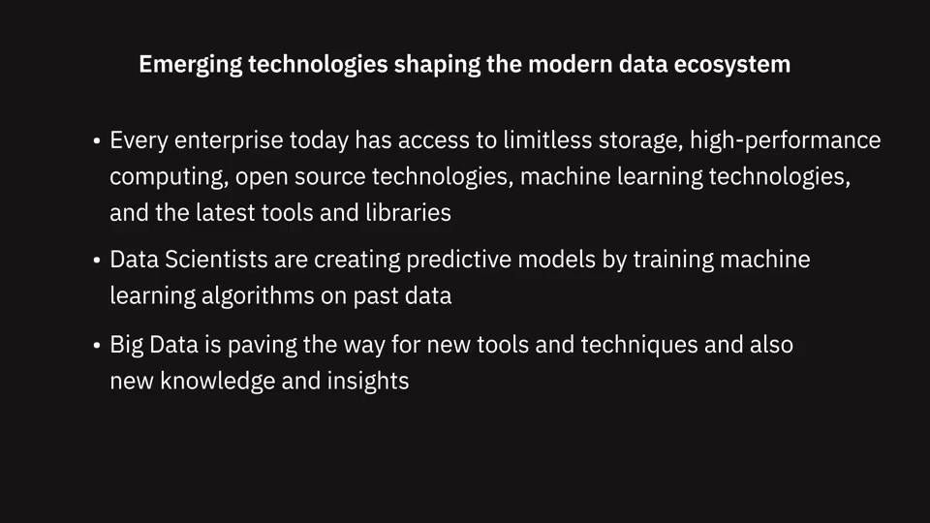

Slide 22
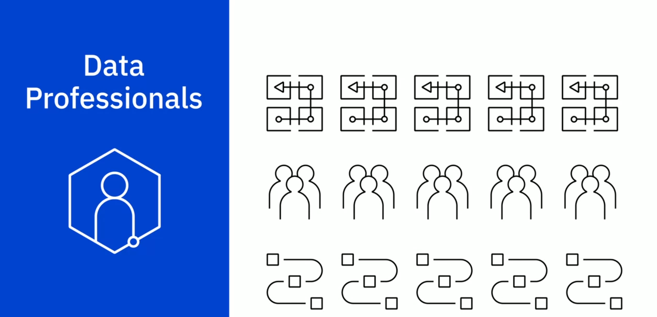

Slide 23
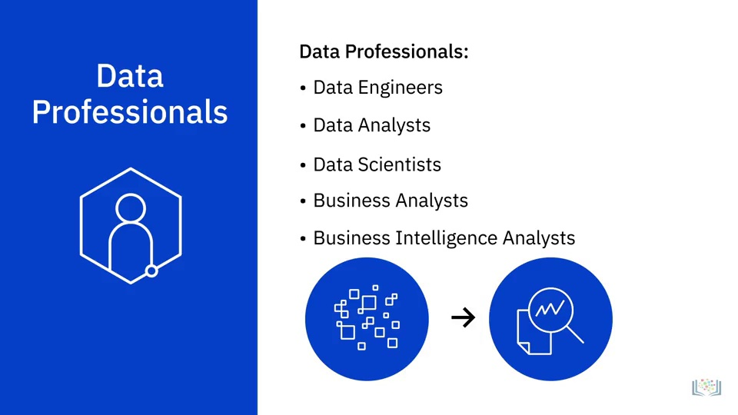

Slide 24
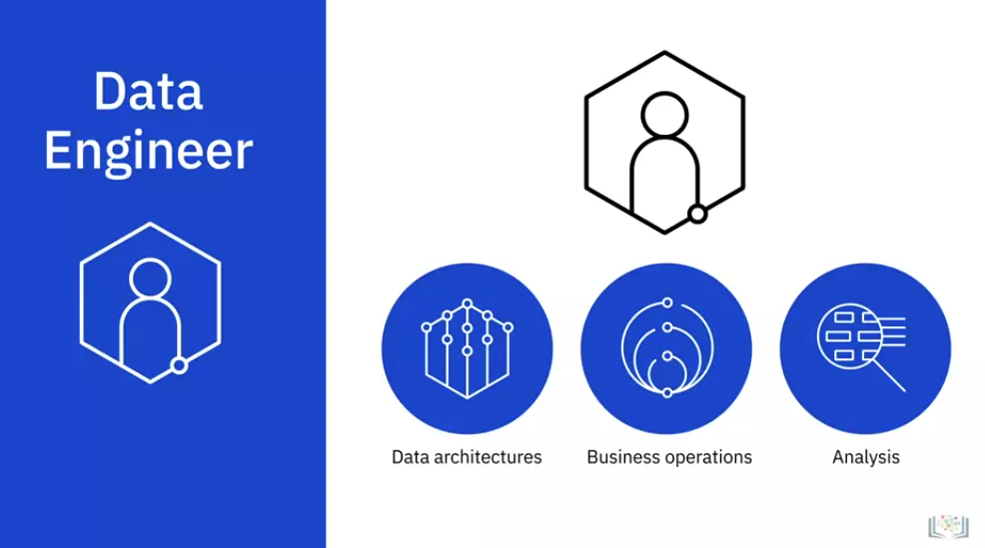
Notes:
Data Engineers are people who develop and maintain data architectures and make data available for business operations and analysis.

Slide 25
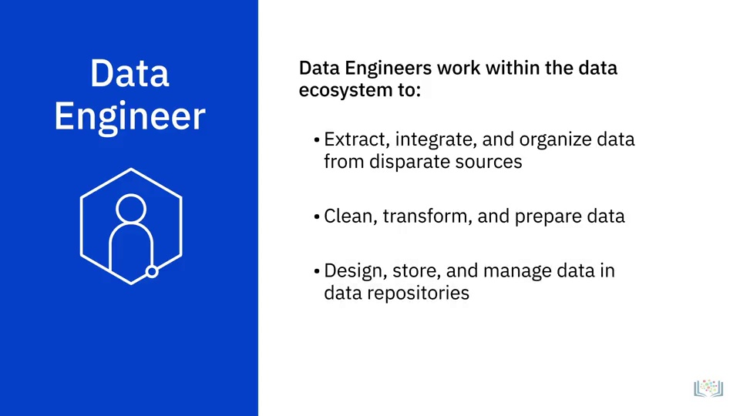

Slide 26
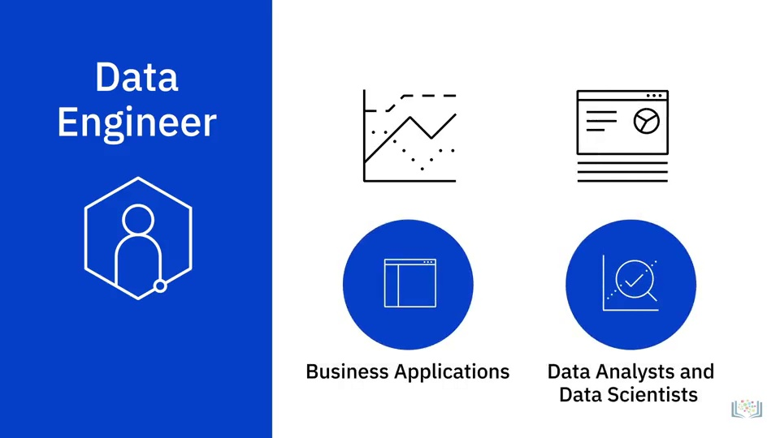
Notes:
They enable data to be accessible in formats and systems that the various business applications, as well as stakeholders like Data Analysts and Data Scientists, can utilize.

Slide 27
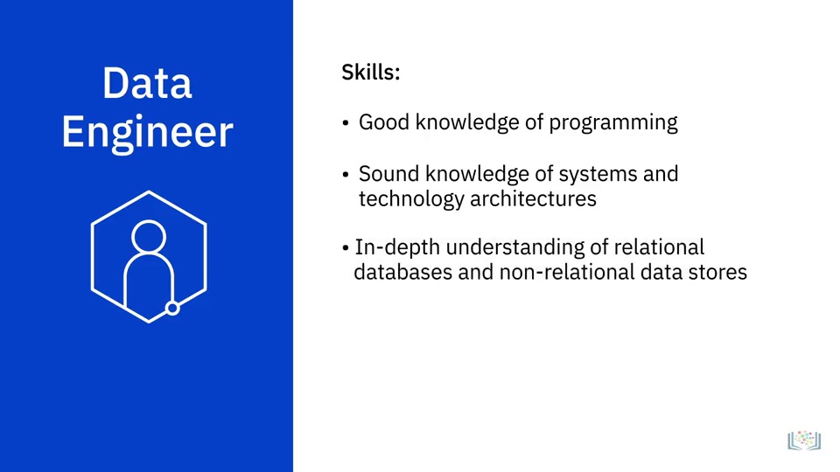

Slide 28
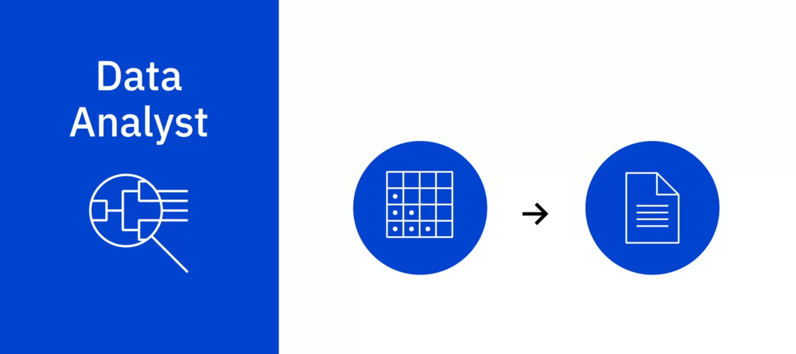
Notes:
In short, a Data Analyst translates data and numbers into plain language, so organizations can make decisions.

Slide 29
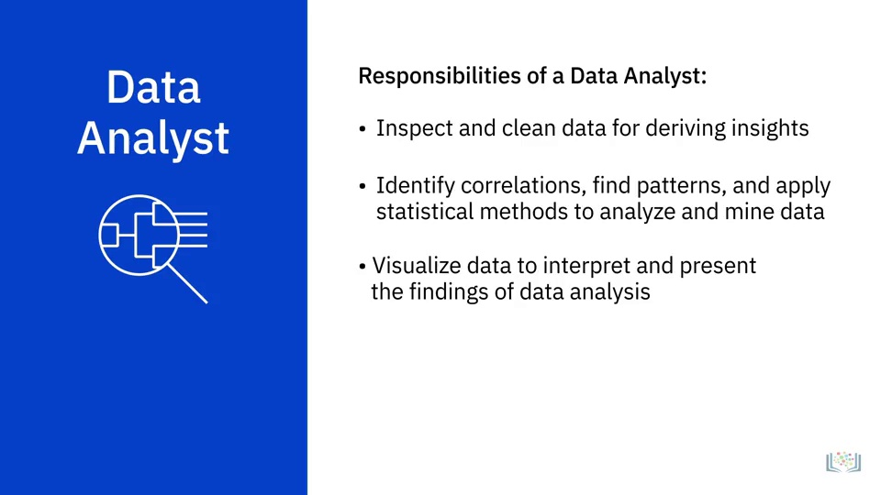

Slide 30
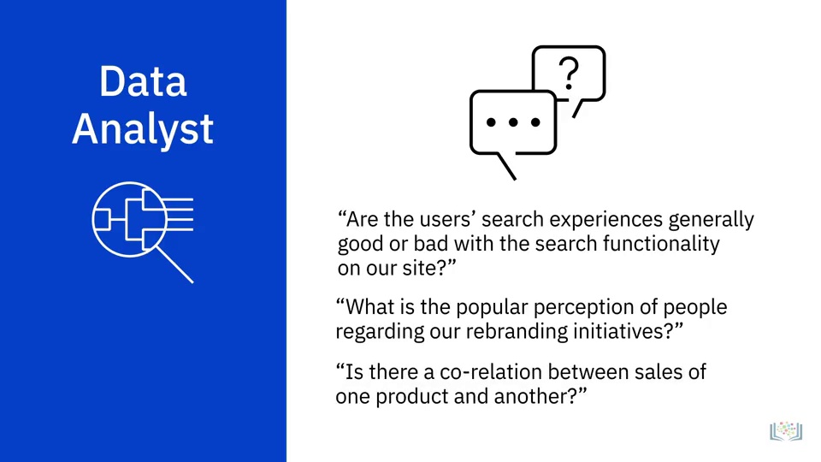

Slide 31
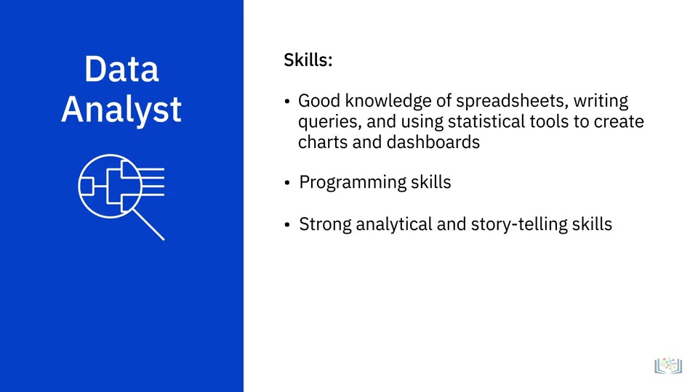

Slide 32
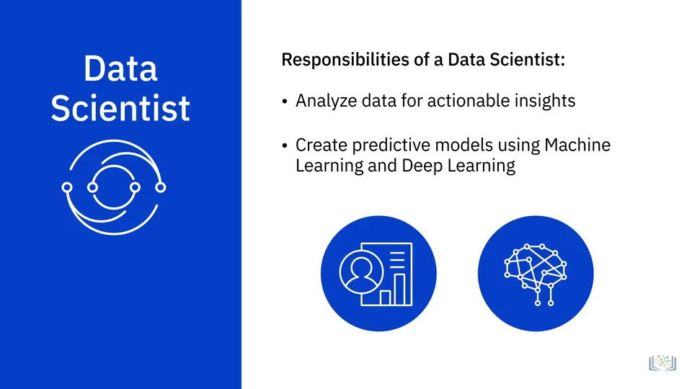

Slide 33
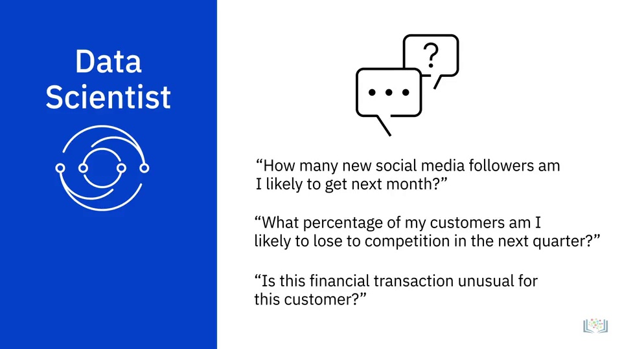

Slide 34
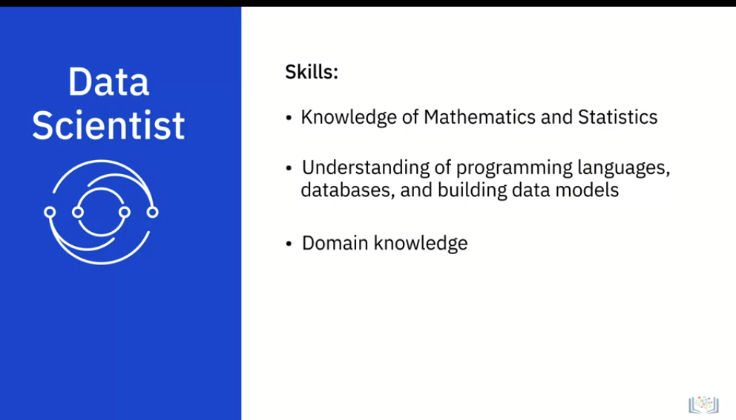

Slide 35
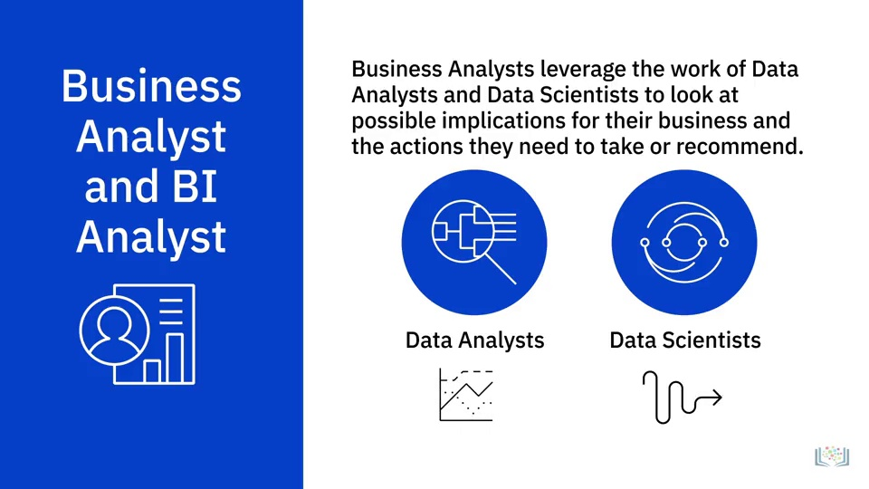

Slide 36
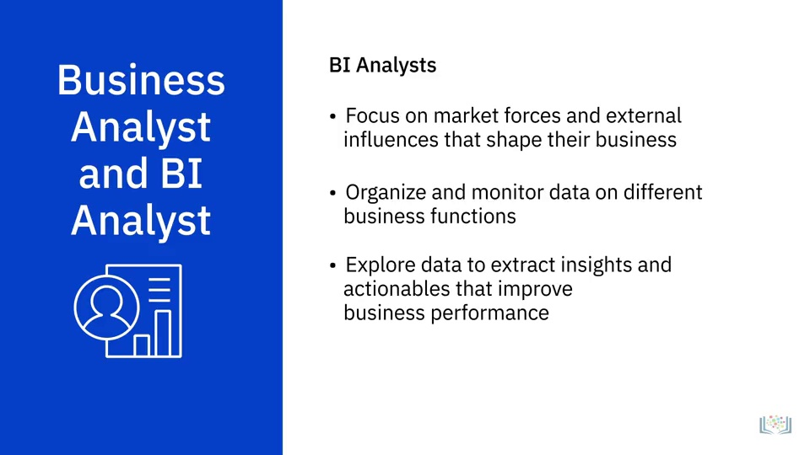

Slide 37
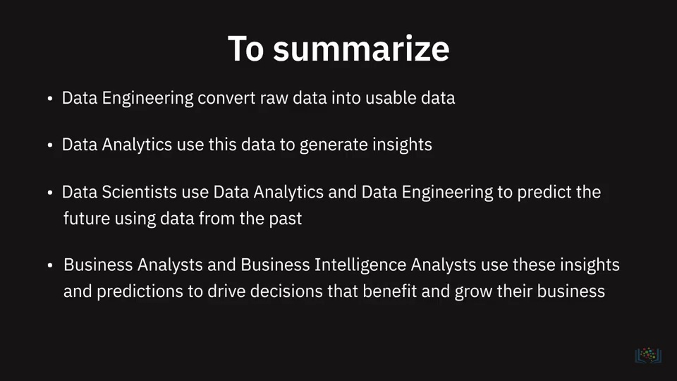

Slide 38
ما هو Data Engineering

Slide 39
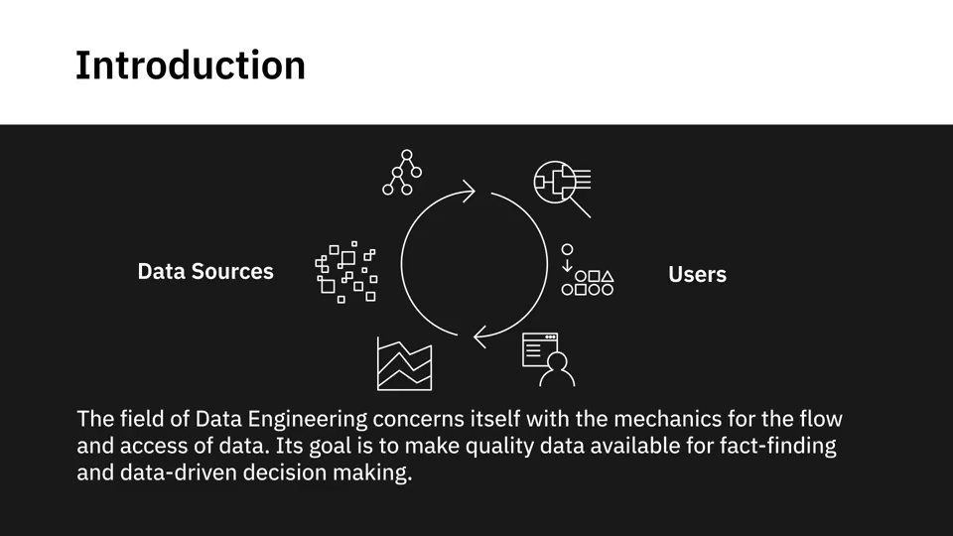

Slide 40
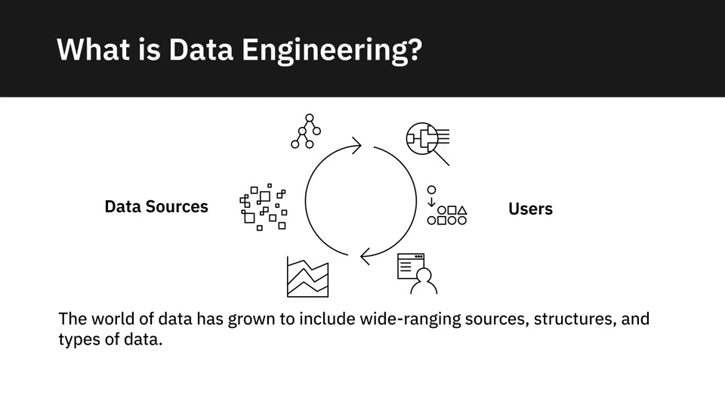

Slide 41
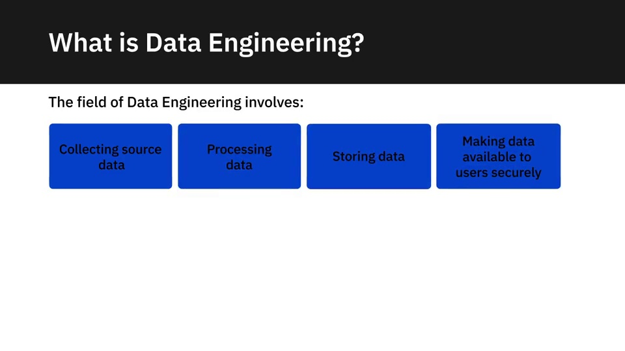

Slide 42
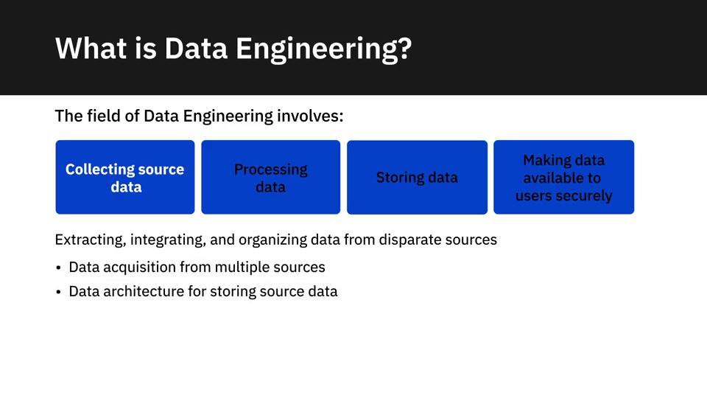
Notes:
The field of Data Engineering concerns itself with the tasks of collecting source data includes extracting, integrating, and organizing data from disparate
sources. To collect required data, you need to:
Develop tools, workflows, and processes that help you acquire data from multiple sources.
Design, build, and maintain scalable data architecture to store data.
Data could be stored in databases, data warehouses, data lakes, or any other type of data repository.

Slide 43
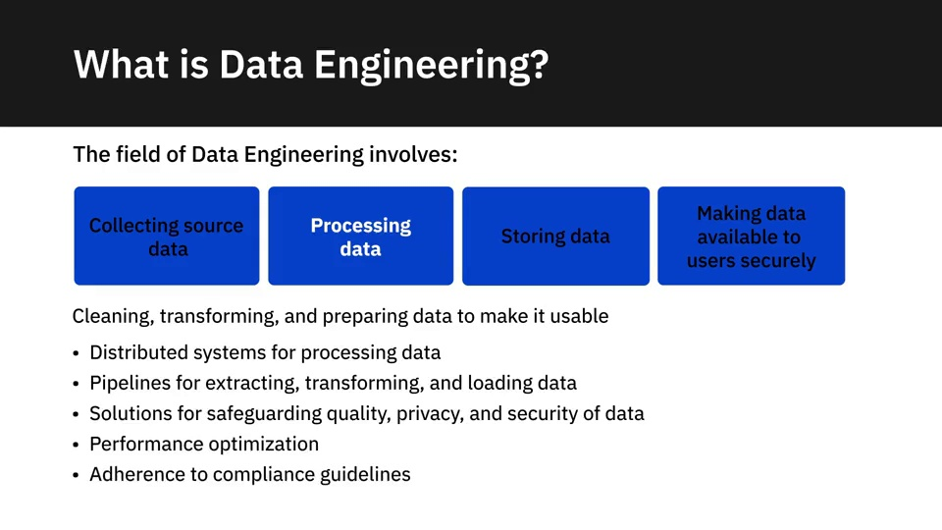
Notes:
Ensure data meets all regulatory and compliance guidelines.

Slide 44
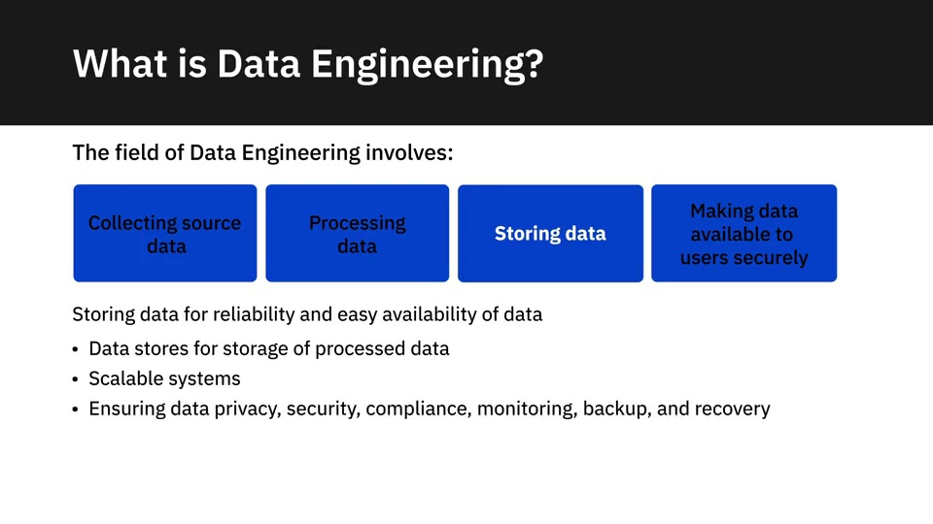
Notes:
مخازن البيانات لتخزين البيانات المعالجة

Slide 45
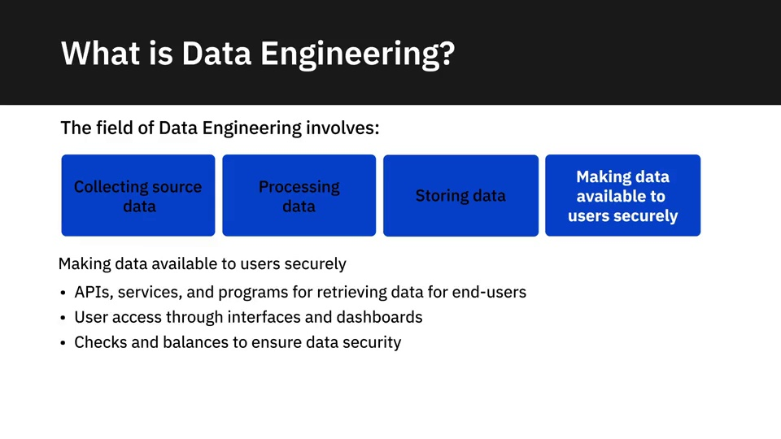

Slide 46
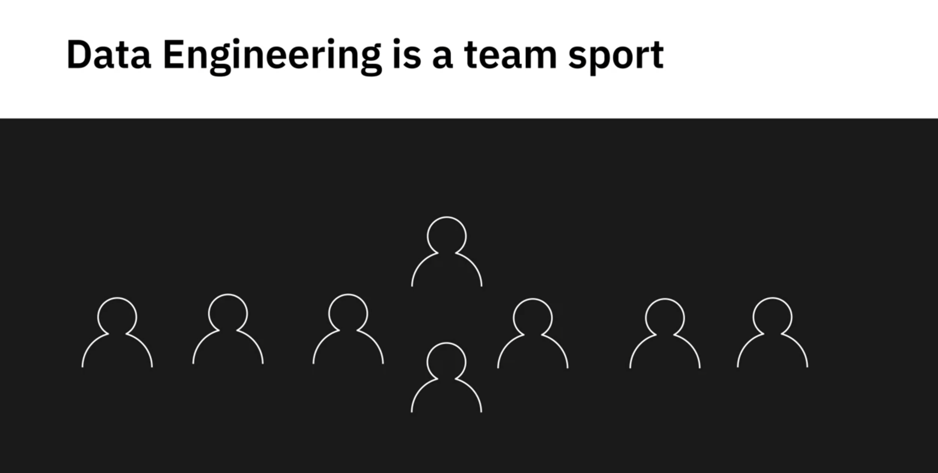
Notes:
No one person is expected to have all the knowledge, skills, and specializations required
for the wide-ranging tasks covered within the scope of data engineering

Slide 47
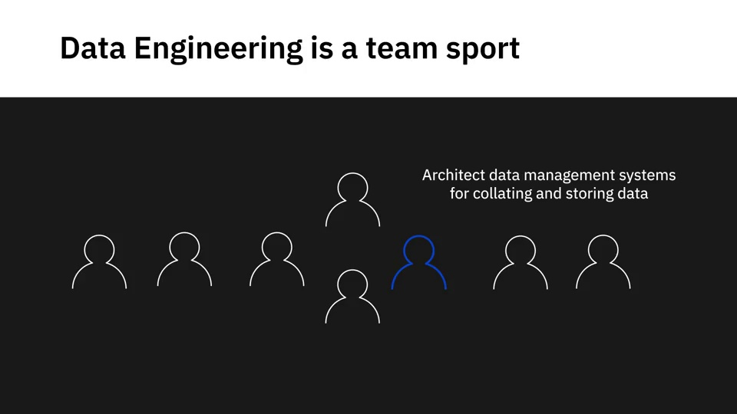

Slide 48
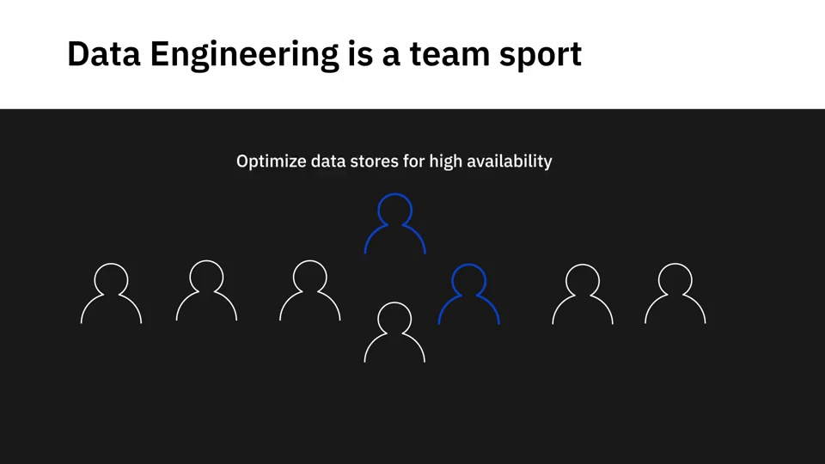

Slide 49
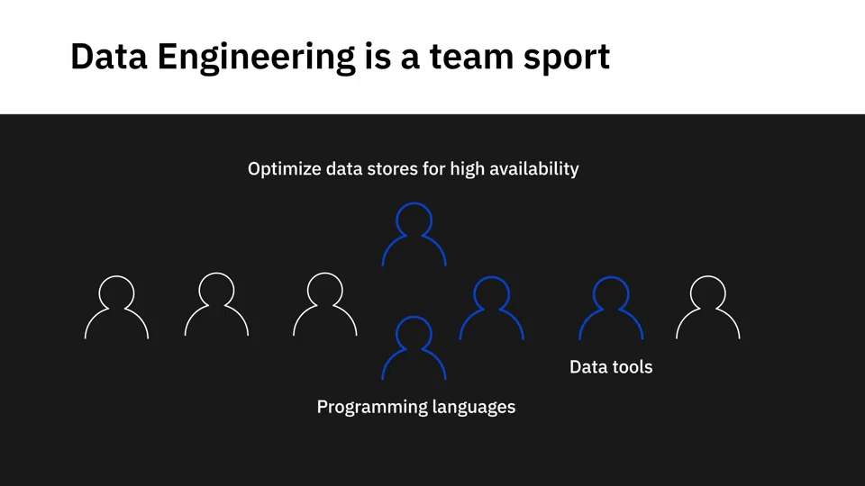

Slide 50
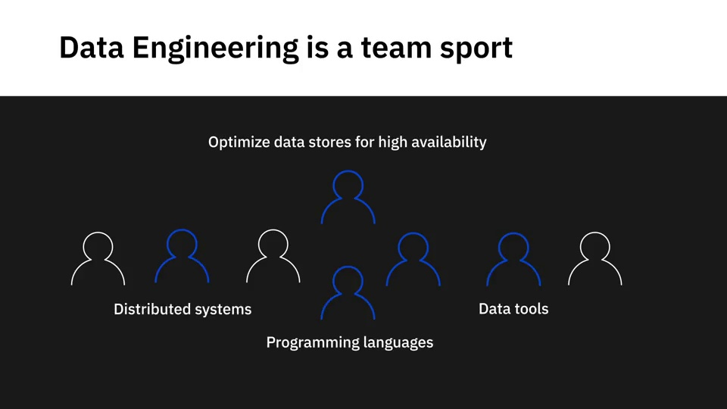

Slide 51
شكراً لكم
Notes:
1- https://t.me/Tharaaedu
2- https://www.linkedin.com/in/mostafanabieh/
3- https://twitter.com/EngMostafaNAI

